Slide 1


AFFILIATE PROGRAM
Empowering communities through a revolutionary, private e-commerce and local service platform. Build your network and unlock limitless earning potential.

Slide 2


THE POWER OF AFFILIATE MARKETING
■
Proven Success: Online platforms like TikTok Shop thrive entirely on robust affiliate marketing programs.
■
Decentralized Sales: Creates a powerful, decentralized sales force driven purely by performance and network reach.
■
Passive Income: Individuals earn steady commissions by promoting products to their dedicated audience.
■
The Next Evolution: Hayahay takes this proven e-commerce model and supercharges it for local services and private networking.

Slide 3



INTRODUCING HAYAHAY.PH
A unified platform bridging local Shops, Providers, and Customers.
EXCLUSIVE & PRIVATE
Hayahay is an exclusive ecosystem. Users enter only via a registered Affiliate Link.
GUARANTEED ATTRIBUTION
Every invited customer or shop is permanently tied to your network, securing your commissions for life.

Slide 4




YOUR ROLE AS A HAYAHAY AFFILIATE
RECRUIT SHOPS
ONBOARD PROVIDERS
INVITE CUSTOMERS
Bring local retail businesses and merchants into the ecosystem. You earn on every transaction made through their virtual storefront.
Share your exclusive private link to build your personal user base. You earn heavily when your network transacts.
Connect skilled service providers (plumbers, mechanics, consultants) to the platform. Their success becomes your success.

Slide 5
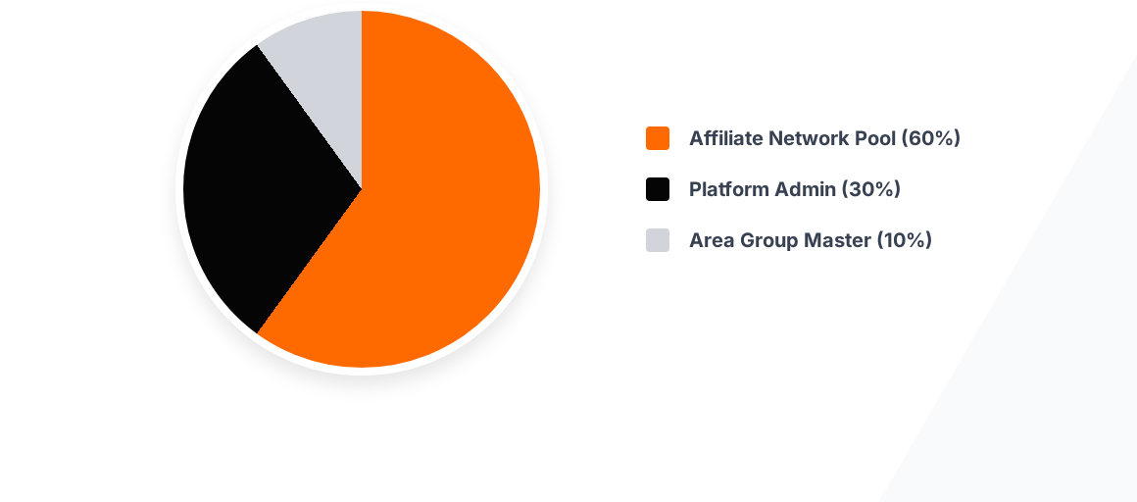
USER TRANSACTION FEE ALLOCATION
For every user transaction, a fixed fee of 20 Pesos is applied. The majority (60%) of this fee is immediately routed back into the affiliate network.

Slide 6
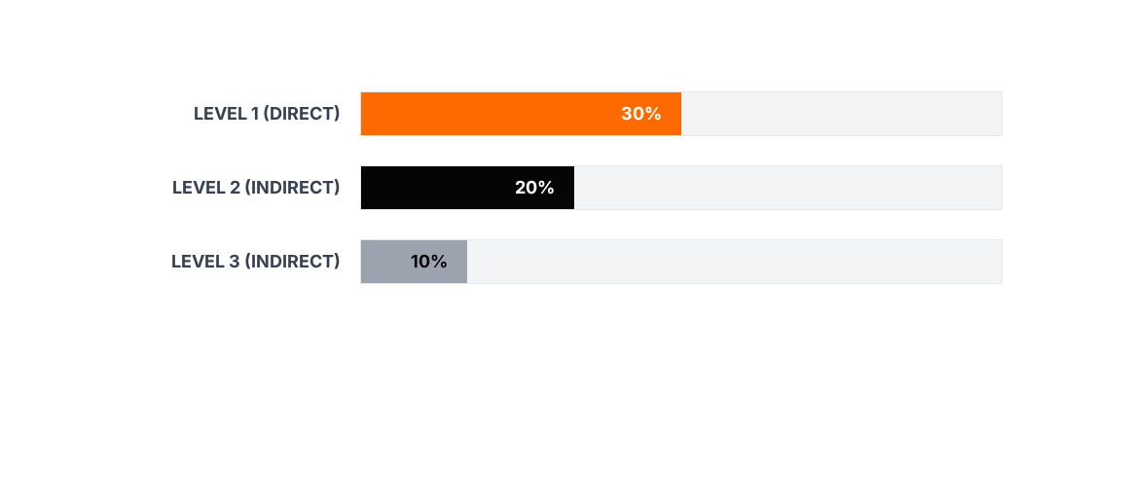
MULTI-LEVEL COMMISSION (USERS)
The 60% Affiliate Pool is distributed across three levels. You earn 30% on users you recruit directly, 20% on users they recruit, and 10% on the third level.

Slide 7

SHOP & PROVIDER EARNINGS
10₱
EARN FROM BUSINESS VOLUME
Beyond the user transaction fees, you earn directly from the businesses you bring into the ecosystem.
PLATFORM CHARGE
For every transaction processed by a Shop or Service Provider you recruited, the platform charges a flat 10 Peso fee. As their recruiting affiliate, you receive a direct 10% commission from this fee every single time they make a sale.
10%
YOUR COMMISSION

Slide 8
AFFILIATE RECRUITMENT BONUS
Grow the Network: Expand the platform's reach by recruiting other motivated affiliates to join your team.
Fixed Bonus: You earn a flat commission of 100 Pesos for every new affiliate that successfully joins through your lineage.
Three Levels Deep: Just like user transactions, this recruitment bonus applies up to the 3rd level. You get paid for building a team that builds teams.
Exponential Growth: This structure heavily incentivizes leadership, mentoring, and rapid geographic expansion.

Slide 9
COMPREHENSIVE EARNING POTENTIAL
Revenue Stream | Transaction Fee | Your Commission | Depth Level
User Transactions | 20 PHP | 30% / 20% / 10% | Up to 3 Levels
Shop Transactions | 10 PHP | 10% | Direct Recruit
Provider Transactions | 10 PHP | 10% | Direct Recruit
Affiliate Recruitment | N/A | 100 PHP Fixed | Up to 3 Levels

Slide 10


WHY CHOOSE HAYAHAY?
UNPRECEDENTED PRIVACY & TRACKING
DIVERSIFIED INCOME STREAMS
You aren't just earning from one source. You build wealth simultaneously by bringing in consumers (users), suppliers (shops/providers), and promoters (other affiliates). It is a complete, self-sustaining economic loop.
Because the platform is closed and invite-only, there is zero leakage. Every single user that enters the ecosystem is permanently hardcoded to an affiliate. Your hard work in generating leads is strictly protected and monetized.

Slide 11


START BUILDING YOUR NETWORK
The earlier you join, the faster you can establish dominance in your local area. Secure the top Shops, Providers, and Users before the market saturates.

Slide 12
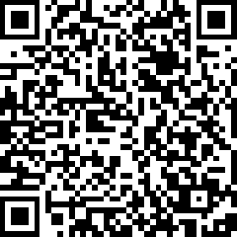

READY TO JOIN?
Unlock the future of localized, private e-commerce.

