Slide 1


The Ultimate WEB & Mobile Application for Goods and Services

Slide 2

OUR PLATFORM
Bridging the gap between Shops, Service Providers, and Customers.

Slide 3
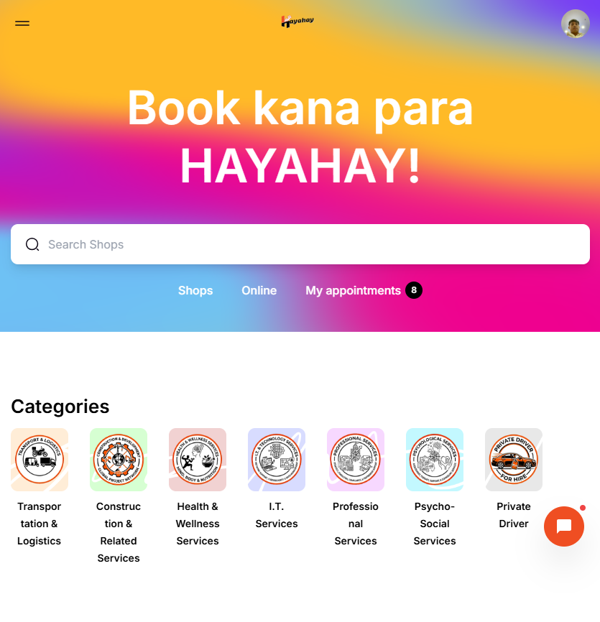
ACCESSIBLE ANYWHERE
UNIFIED EXPERIENCE
Hayahay PH is fully operational on Web, Android Playstore, and Apple Appstore. Our seamless interface allows users to browse products and book exclusive services with ease.
Currently under development for even more exciting updates!

Slide 4





EXCLUSIVE PRIVATE ECOSYSTEM
SHOPS & PRO'S
AFFILIATES
PRIVATE ACCESS
Local businesses and service providers list their exclusive offerings.
The backbone of recruitment for shops, providers, and customers.
Only users with an affiliate link can enter the platform.

Slide 5
UNMATCHED INCENTIVES
60%
3-LEVEL COMMISSION STRUCTURE
Affiliates earn from their own recruits and the tiers below them:
30% - Direct Recruits
20% - Second Level Tiers
Total Commission
10% - Third Level Tiers

Slide 6
TRANSACTION FEE BREAKDOWN
Transaction Type | Platform Fee | Affiliate Share | Admin/GM Share
User Purchase | 20 Pesos | 60% (12 PHP) | 30% Admin / 10% GM
Shop/Provider Sale | 10 Pesos | 10% (1 PHP) | 90% Operations
Affiliate Recruitment | - | 100 PHP/Recruit | Up to 3rd Level

Slide 7



PARTNERSHIP OPPORTUNITIES
AFFILIATE
GROUP MASTER
CATEGORY OPERATOR
1,000 PHP Activation Fee
100,000 PHP Franchise Fee
50,000 PHP Operation Fee

Slide 8


THE GROUP MASTER (GM)
CITY LEADERSHIP
The GM is our strategic partner for a specific city. Key responsibilities include:
•
Approve and manage local Shops.
•
Oversee Hayahay Riders in the area.
•
Earn 10% from all city transactions.
•
Earn 40% from all affiliate activations.
•
20,000 PHP Share from category operator purchases.

Slide 9
PRIVATE CATEGORY OPERATOR
Exclusive Operation: Purchase a category (e.g., "Transport & Delivery") and become the sole provider for that service on the platform.
Investment: 50,000 PHP per category.
Recruitment Bounty: 5k PHP for the direct affiliate, 20k PHP for the GM, and 25k PHP for Hayahay Admin.
High Return: Capture 100% of the service requests within your exclusive domain.

Slide 10

HAYAHAY MANAGER
NO INVESTMENT? NO PROBLEM.
For qualified applicants who lack the initial capital, we offer the Hayahay Manager position.
This is a performance-based role where you operate services and manage providers just like a Category Operator. Earn based on the success of the providers you lead.
Interviews and assessments are required for this elite role.

Slide 11
THE PATH AHEAD
PHASE 1
PHASE 2
PHASE 3
PHASE 4
Web & App Launch (Ready)
GM & Affiliate Recruitment
Category Exclusive Operations
Nationwide Service Expansion

Slide 12

JOIN THE FUTURE OF
HAYAHAY PH
Looking for partners and investors to revolutionize service delivery.
Available on App Store & Play Store
Visit our website for activation and partnership applications.
Q & A

