Slide 1

ONLINE EMERGENCY HOTLINE
The Philippines' First Video-Enabled Emergency Response System

Slide 2

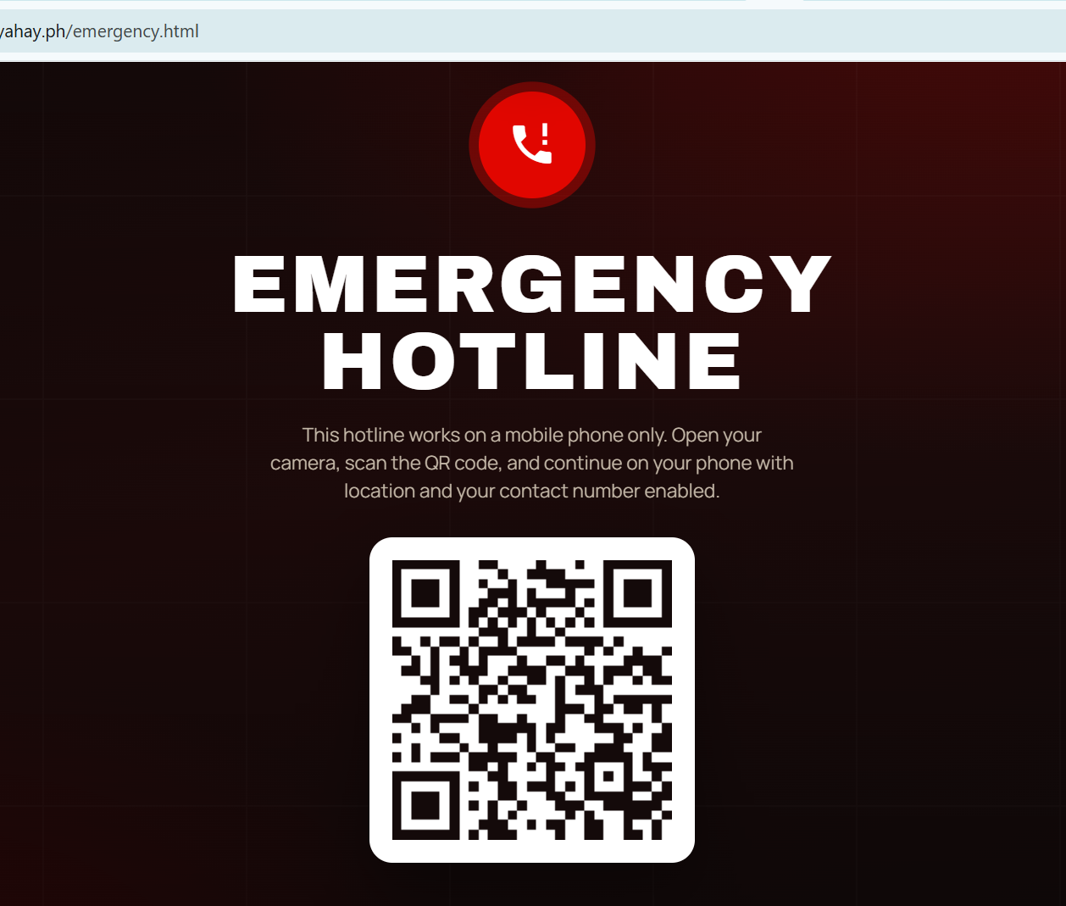
The Challenge with Legacy 911
Traditional voice-only emergency calls severely limit a dispatcher's situational awareness.
Callers in distress struggle to accurately describe their exact location.
Responders lack visual context of the scene before arriving.
This leads to delayed dispatch times and potentially misallocated resources during critical moments.

Slide 3
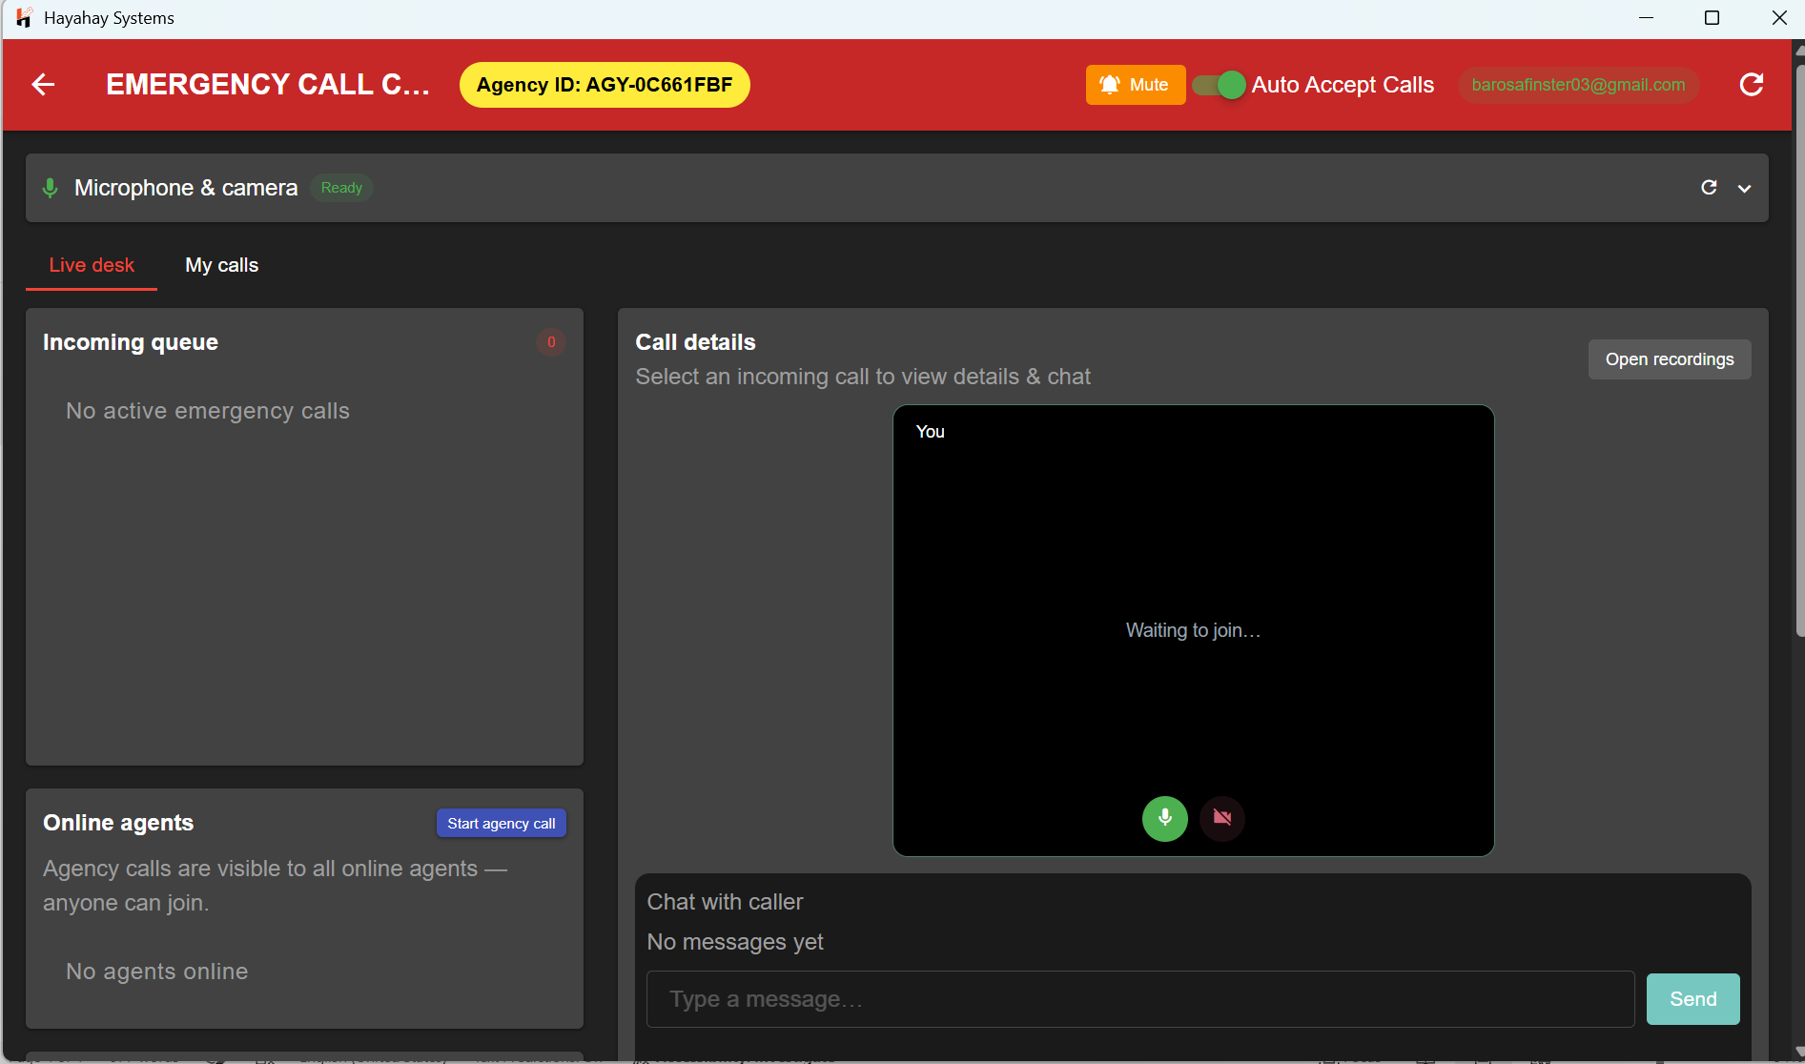
Instant Visual Context
Our system transforms any smartphone into a live command feed.
Callers connect directly to the emergency desk via a secure, high-quality video link.
No application installation is required on the user's device.
Agents instantly see the situation on the ground, allowing for accurate assessment and faster, appropriate triage.

Slide 4
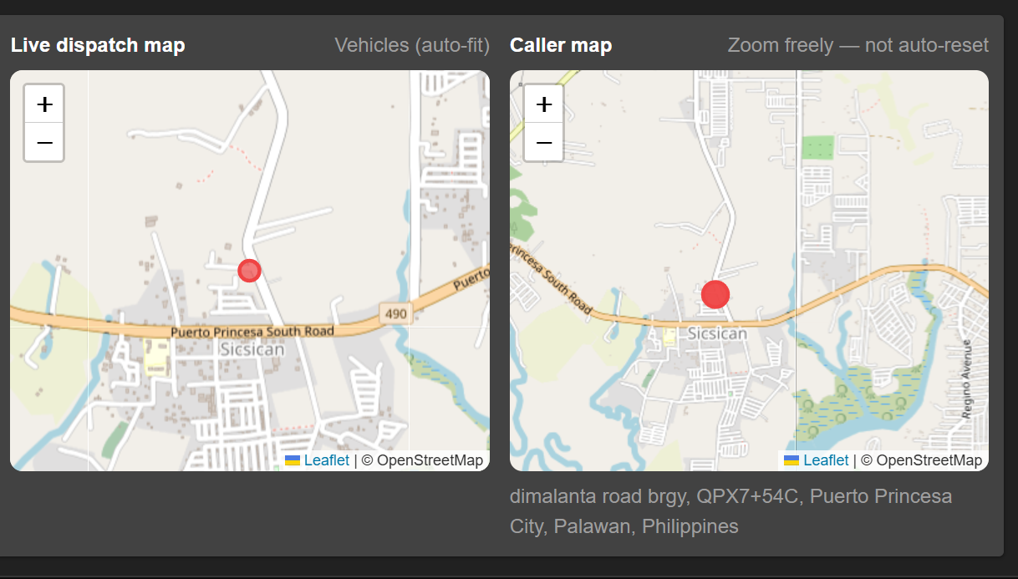
Precision GPS Geocoding
Eliminate the guesswork in locating a crisis.
The system instantly requests and captures the caller's exact GPS coordinates upon connection.
Location is displayed on a Live Dispatch Map for the agent.
Removes the burden from panicked callers to explain where they are, saving critical minutes.

Slide 5









Multi-Agency Collaboration
Medical & Rescue
Fire Protection
Police & LGU
Dispatch ambulances with prior visual confirmation of patient status and injury severity.
Assess the scale of the fire and environmental hazards before trucks arrive on the scene.
Multiple online agents can join the active call to coordinate local barangay response instantly.

Slide 6
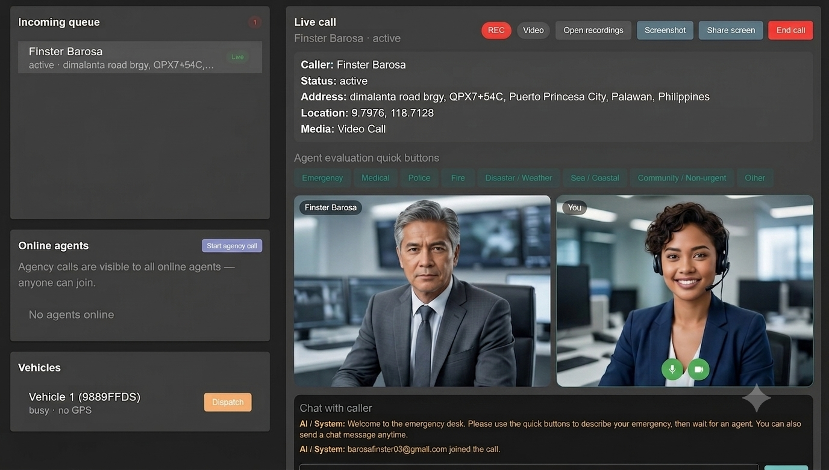
Centralized Command Desk
A powerful, Software Application dashboard designed for high-stress environments.
Manage incoming call queues efficiently.
Automated Logging: Calls are automatically recorded on the agent's computer.
Agents can easily capture screenshots during the live feed for evidential and reporting purposes.

Slide 7
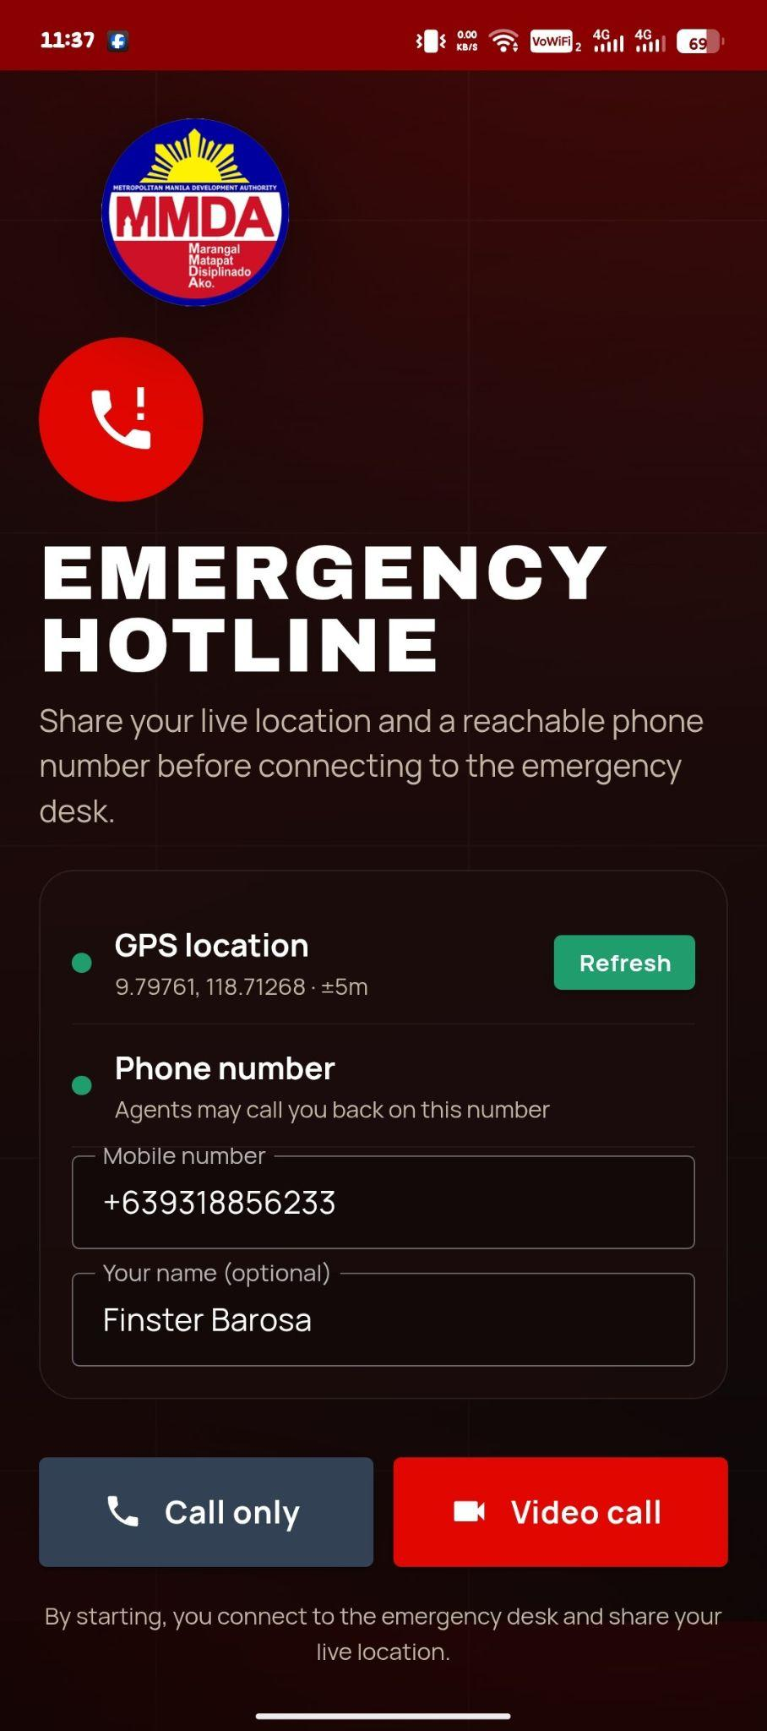
Frictionless Public Access
Empowering citizens with immediate access.
Accessible via a simple web link or by scanning deployed QR codes.
Ideal for placement in public transport, terminals, government buildings, and street corners.
Works on any modern smartphone browser without downloading third-party applications.

Slide 8
Ready to Modernize?
Upgrade your LGU's emergency response capabilities today.

